Slide 1

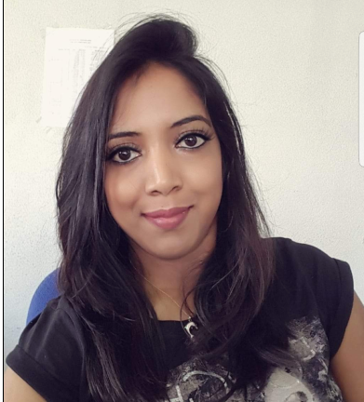

Experience
Areas of expertise
IPSEN (Feb 2021 – To Date)
BI Tester
Integration and Acceptance Testing for all BI implementations
Data Integrity testing.
Japan Tobacco International (JTI) (Nov 2019 – Jan 2021)
Power BI Consultant
Developer for Power BI reports
Analysis of data using Microsoft tools.
Develop and update technical documentation
Develop and execute database queries
Accenture (Avanade) (Jun 2019 – Oct 2019)
Trainee (Intern)
Development of POC for Power BI development.
Functional
Software Engineering
Agile
Testing abilities
Analytical abilities
Industries
Sales
Pharmaceutical
T-SQL
Azure
SQL Server
GIT
Azure DevOps
Azure Data Factory
Power BI
Web (HTML5/CSS/JS)
DAX
Aviksha Goobdassur
Microsoft BI Developer
Application Development Associate
Education
Professional background
MSc(Hons) Applied Software Technologies
University of Mauritius (2019-2020)
BEng(Hons) Telecommunications and Computer Networks
London South Bank University (2009-2012)
Experience in Power BI development | Azure | Big Data | Agile
Proficiency in using Microsoft Analytics tools for the development of Power BI reports.
Profile:
Committed, proactive & self-motivated.
Always willing to learn new technologies.
Certifications
- Scrum Fundamentals PSM 1
- Azure Fundamentals (AZ-900)

Slide 2


BI Tester
(2021.Feb – To Date)
-Perform integration testing across all layers
-Data integrity checks.
BI Tester
Skills & technology applied
Analyzing User Stories and understanding requirements for testing purposes.
Writing test scripts/test cases to carry out Integration and Acceptance testing.
Execution of test scripts in QUAL environment across all layers (Bronze, Silver, Gold, DWH, Cube).
Logging defects/bugs for action to be taken.
Power BI dashboard testing.
Updating and maintaining test book as per requirements.
Skills
Analytical abilities
Agile
Communication
Technology
Azure
Power BI
SQL

Slide 3

Power BI Consultant for a leading tobacco company
(2019.Nov – 2021 Jan)
-Extract, Transform and Load data to Power BI for creation of reports
-Data modelling and loading using Power BI/SSAS
Development of BI Reports with Power BI / SSRS
-Implement, maintain and provide support for business web application.
Power BI Consultant
Skills & technology applied
Collecting technical requirements from client.
Translating business needs to technical specifications.
Designing, building and deploying BI solutions.
Data manipulation and data visualization.
Developing and executing database queries to be used for PBI reporting.
Creating visualizations and reports for different projects.
Developing and updating technical documentation.
Building dashboards as per client requirements.
Skills
Analytical abilities
Agile
Communication
Technology
Power BI
DAX
SQL

